Slide 1
THE NWP (R)EVOLUTION: How and Why the NWP Will Keep Going
Spring meeting 2018
Laura Stokes

Slide 2
Why I’m here today
To offer a perspective on the NWP: How I see its unique strengths and assets going forward
To applaud and encourage you as you shape the NWP’s future

Slide 3
My lenses: Research and practice
With Inverness, lens of research – 1994 to 2017
Summer institute participants—annual surveys
Site activities across the network—annual data
Teacher leadership
Special initiatives: Project Outreach, Technology, New Teachers, Focus on Standards
College, Career, and Community Writers Program
With NWP, lens of practice — 1982 to 1994
Writing teacher
Area 3 WP site director at UC Davis
CWP co-director
NWP Advisory Board
36 years!!!
😯

Slide 4
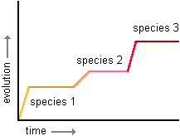
The NWP’s 4th Phase in a continuing evolution
1. 1970s and 80s: Patchwork of startup/growth grants
2. 1990s and 2000s: Stable federal support
3. 2011 to 2017: Multiple large federal grants in the competitive era of 2011-2017
4. 2018—? Reliance on non-federal sources of support
Punctuated equilibrium: “Long periods of stability and short episodes of change” due to “major environmental changes.”

Slide 5
What unique set of strengths will help the NWP survive as it adapts?
Part I. Observable features
Its design as a NETWORK
B. Its capability to develop
TEACHER LEADERS and promote their many contributions
Yield: A vast reservoir of “capital,” i.,e., assets of many kinds—that you can draw upon for future work

Slide 6
Unique strengths, cont.
Part II. Below the surface
A. CORE VALUES that guide and shape the work
B. Bringing into expression the BEST OF WHAT IT MEANS TO BE HUMAN
The roots and DNA that inspire, generate, and shape the network and teacher leadership
Notes:
I

Slide 7
A. The NWP’s design as a NETWORK
PART I. Observable features

Slide 8
The NWP Network is a connected and connecting structure
Districts, Schools, other Partner Organizations
Federal, Regional & State Policy Contexts
Funders: States, Philanthropists, Locals
The Field: Teachers, Researchers
Site
Site
NWP
Network
A connecting
structure
Site
Site

Slide 9
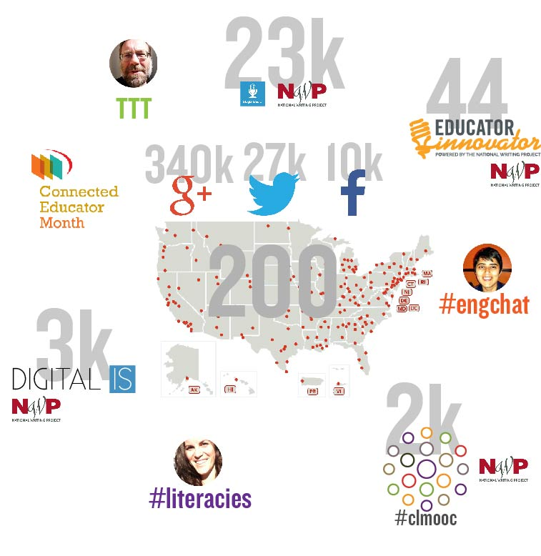
Network links are not abstractions—they are connected people

Slide 10
The same connection dynamics function in smaller sub-networks
State networks
E.g., Kentucky in the annual report
Regional networks
Shared interest networks
Your local site network

Slide 11
B. The nWP’s capability to develop TEACHER LEADERS and promote their many contributions
PART I.

Slide 12
Nearly 90 thousand teachers have participated in Summer Invitational Institutes since 1974

Slide 13
The NWP is expanding its capacity to generate leadership
Invitational Institutes
The New Pathways to Leadership Initiative

Slide 14
Teacher leaders contribute in countless ways
Advocating for what's right for students
Staying informed about practice and policy
Opening the classroom door and going public with teaching
Working "alongside" teachers and leading collaboratively
Taking a stand, speaking up, being passionate about teaching
Learning and reflecting on practice as a teacher and leader
Sharing classroom practices that work
~7,500 NWP teacher-leaders are active any given year, serving ~80,000 teachers.

Slide 15
NWP Teachers persist
NWP teachers stay in education for 22.7 years
72% stay in the classroom
Others become
Principals and district administrators
University faculty members
Leaders in education improvement organizations

Slide 16
Yield: A reservoir of “capital”—i.e., assets to draw from to keep going
Leadership—in classrooms and throughout the system
Knowledge—collective, and in sharable forms
Relationships—personal and organizational
Designs—for teacher learning, and for ongoing knowledge forming and sharing
Evidence of effectiveness
Experience—individual and shared
Visibility and collective voice

Slide 17
A. The CORE VALUES and principles that shape the nwp
PART II. The roots and the DNA

Slide 18
Community
“A driving principle behind every one of the local sites of the NWP is to offer teachers both a strong, welcoming professional home and community of learners and an invitation to co-create that community.” –Heenan, et al., 2017
“I am learning so much…it is sort of a networking collaborative thing, and it is really kind of amazing to find so many like-minded people that I can talk with…I feel like I am always in PD because I am always talking with someone about writing.”
- Teacher in C3WP
“She made a comment, ‘If I go to another school district, will I not get to be part of the Writing Project anymore?’ I said, ‘Honey it doesn’t matter where you are, you are going to be part of the Writing Project wherever you are.’”
- C3WP teacher leader

Slide 19
Egalitarianism
Approaching every colleague as a potentially valuable contributor to professional learning and community
The NWP has no place for deficit thinking.
“The NTI people stated that specifically at the beginning, ‘The reason we are going to be here—the primary goal—is to treat each other like the professionals that we are.’”
- Novice teacher in NWP New Teacher Initiative, 2006
“When you are a thinking partner to a teacher, it is more than giving her some ideas… it is a whole different mindset.”
- Teacher leader in the C3WP, 2016

Slide 20
Inquiry
“Permeating the entire NWP culture is the idea that constant questioning and searching are fundamental to good teaching.”
Lieberman and Wood, 2002.
“The core of the idea of our teacher inquiry class is that [inquiry] is helping the new teachers reframe how they look at their work. One of the teachers in the class last week said, ‘Every time something comes up in my class, I stand back and think – Hmmm?’ So as novice teachers assimilate inquiry, and approach what they do in their classrooms in that way, then they are more likely to stay in the profession. And that’s because they are likely to be more successful. Because it’s a way of getting better results, and having teaching be a more satisfying process.”
- Site Coordinator in New Teacher Initiative

Slide 21
B. bringing into expression the BEST IN WHAT IT MEANS TO BE HUMAN
PART II.

Slide 22
A voice—and a desire to participate
Helping TEACHERS develop their voices and participate—
Every teacher is a writer in the NWP.
More than 1,600 authors have contributed to the NWP website.
Helping STUDENTS develop their voices and participate—
Letters to the Next President: 13,000 students wrote in 2016.
Rural Voices Radio, Teen Ink, other outlets
The College, Career, and Community Writers program promotes informed writing with a message

Slide 23
A joy in learning—and in sharing learning
“You are always learning something else that you can do better…I think it is exciting to share that, so that other colleagues get that same wonderful feeling…It makes me happy that they are happy, and that their kids are happy.”
- Emerging teacher leader
“I love going out because when I see something that works, I can share it with other sites, and I can share it with my site, and I can put it to use in my classroom, and so it just goes back and forth.”
- Experienced teacher leader

Slide 24
A desire to help—with a belief that all can thrive
“There are thousands of teachers out there with the same capacity as any of us, the same desire. The only difference is that we were given an opportunity. A whole world opens up when you give someone an opportunity to be mentored and to lead.”
- NWP teacher leader
“I will trust [my students] a lot more next year to do some of that harder work…I should have started sooner building some of those skills with them, because they totally can do it…I learned that I could have expected more from them.”
- C3WP program participant
“There will always be people helping. Look for the helpers.”
- Mr. Rogers’ mother

Slide 25
Let’s put this all together

Slide 26
The NWP at 44 years…
The visible strengths and the below-the-surface strengths, working together, have formed the NWP as a national and local infrastructure for educational improvement that is unique in its effectiveness, scale, and longevity.
The NWP remains revolutionary in the nature of its commitment to youth development, teachers’ growth as professionals, and the strengthening of the teaching profession.

Slide 27
…And counting!
The accumulated NWP assets will enable you to function and adapt during this phase of evolution:
You have leadership, knowledge, relationships, designs for teacher learning, resources and materials.
The NWP still has a strong case to make to policy-makers and funders:
While the environment may have changed, the NWP is still the best investment in educational improvement.
The NWP’s record—grounded in practice, substantiated by evidence, demonstrated over 44 years—is as strong as ever.
The NWP is working, and it is here to stay. Support is still needed and will make a difference for students.

Slide 28
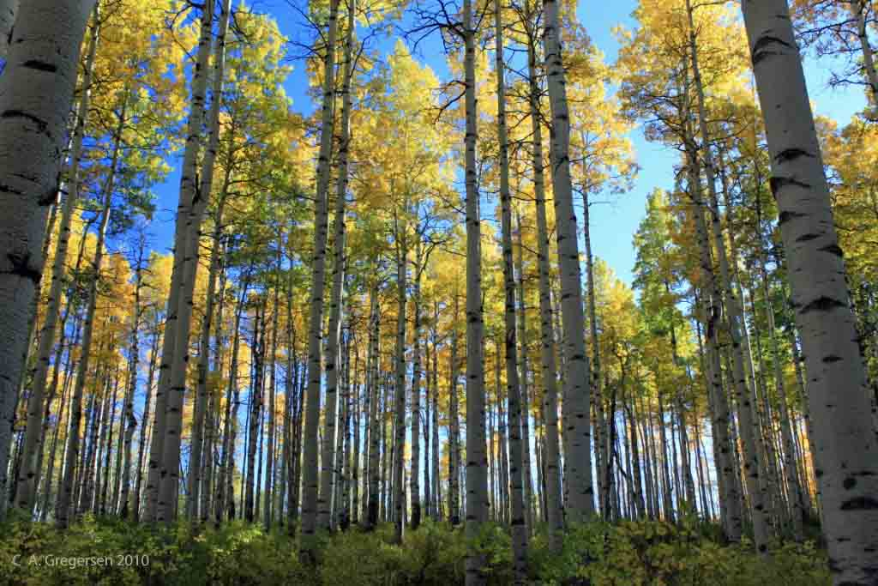
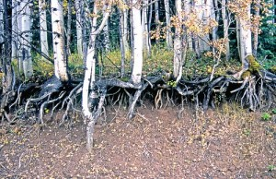
How does the aspen sustain itself as the largest living organism?
Shared root
system

Slide 29
A final thought to carry with you
“The thing I love about the Writing Project is that this is going to carry on despite me and beyond me, and I love contributing to something bigger than myself. I can get the ball rolling in a local area, and then it is going to become about what these next generations of leaders do, and I love that idea.”
- NWP teacher leader

Slide 30
Sources
Slide 4: http://anthro.palomar.edu/synthetic/synth_9.htm
Slides 18, 19, 20: Heenan and Houghton. 2006. The NWP’s New Teacher Initiative: A Study of Outcomes, Design, and Core Values. http://inverness-research.org/2016/08/11/ab2006-03_rpt_nwp-nti-report/
Slides 18, 19, 23, 24: Inverness Research. 2017. College, Career, and Community Writers Program Portfolio. http://inverness-research.org/2017/12/27/portfolio-c3wp/
Slide 14: Lieberman and Friedrich. 2010. How Teachers Become Leaders. Teachers College Press.
Slide 20: Lieberman and Wood. 2002. The Work of the National Writing Project: Social Practices in a Network Context. The College Board.
Slides 9, 10, 14: NWP Annual reports and NWP web site.
Slide 12: Inverness Research analyses. National Writing Project Portfolio. http://inverness-research.org/2017/12/27/portfolio-nwp/
Slide 15: NWP Legacy Study. 1994-2006. https://www.nwp.org/cs/public/print/doc/results/leadership_legacy.html

